Slide 1

THE FOLLOWING IS TO BE VIEWED BY LEVEL 5 CLASSIFED PERSONNEL ONLY. IF YOU ARE NOT LEVEL 5 PERSONNEL, EXIT THIS PROGRAM IMMEDIATELY.
IF YOU HAVE LEVEL 5 CLEARANCE…..
CLICK TO CONTINUE TO THE NEXT SLIDE NOW

Slide 2
Atoms, Molecules, Elements, Compounds, and Mixtures

Slide 3
This is a briefing is about a HIGHLY SECRET agency that makes life possible for me, you, and everyone you know.
The agents of this organization are highly specialized. They each possess the traits and skill necessary to perform very specific functions that are essential to the survival of human-kind. These agents are all around you, and you don’t even know it. You depend on these agents and come in contact with them every day.

Slide 4
Be advised that what you are about to hear is HIGHLY classified. You must not share this information with anyone. If you breathe a word of this to ANYONE we will send out a trained assassin to ………
tell your parents, and you’re going to be grounded for at least a week
Now here is one of our agents who will tell you more about our organization.

Slide 5
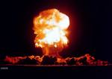
Agent HHO (That’s double H–O, you know H₂O) is here to provide you with intelligence on the different types of matter. Many of our agents are among this matter.
This is agent double H-O. Whatever you do, don’t say that he looks like Elmo. He HATES that!
Your mission, should you choose to accept it, is to learn about the Atoms, Molecules, Elements, Compounds, and Mixtures that are all around you. GOOD LUCK!
This message will self-destruct in 5 seconds.

Slide 6
O.K. recruits, the first thing that you need to know about is a very important TOP SECRET unit called the atom.
An atom is the smallest basic unit of matter.
There are more than 100 different types of atom. These atoms can combine in different ways to make up anything that you can think of. This screen, your pencil, the food and water that you eat and drink, the air that you breathe, and even you are made of atoms.

Slide 7
Think of what could happen if the enemy knew what these atoms can do. Remember all of this is highly classified and isn’t to be shared with anyone!
If you were to tell anyone about these atoms and that they can be combined to create ANYTHING, we would have no choice but to…….
Tell your science teacher, and you would DEFINITELY get detention.

Slide 8
Another thing that you need to know about atoms is that they are EXTREMELY small. Millions of atoms would fit into the period at the end of this sentence. Now just think of how many atoms you have in your body.
The millions upon millions of atoms that it takes to make up everyday-sized objects are held together by something called
BONDS…….
CHEMICAL BONDS

Slide 9
When two or more atoms bond together, they form a particle called a molecule.
Water is known as H₂O because it is a molecule that is composed of two hydrogen (H) atoms and one oxygen (O) atom that are BONDED…..CHEMICALLY BONDED together.
H
H
O
Salt, carbon dioxide, sugar, hydrogen peroxide, and baking soda are just a few more of the millions of types of molecules that are all around you. Many of these molecules, like double H – O, are secret agents.

Slide 10
Vibrating H₂0 molecule that is “shaken, not stirred”
The atoms and molecules are always in motion. Even in solid objects that show no signs of movement, the atoms are at least vibrating and twisting in place.
The reason that you cannot detect this movement in atoms is because the atoms are so small.

Slide 11
Now when it comes to molecules there are two types. The first type is called an element.
An element is a substance that contains only a single TYPE of atom.
The number of atoms doesn’t matter as long as they are all the same type. Gold, for example, is an element. A gold coin contains millions and millions of atoms, but all of the atoms are the same type of atom, gold.
As I mentioned earlier, there are more than 100 different atoms. That means that there are more than 100 elements.

Slide 12
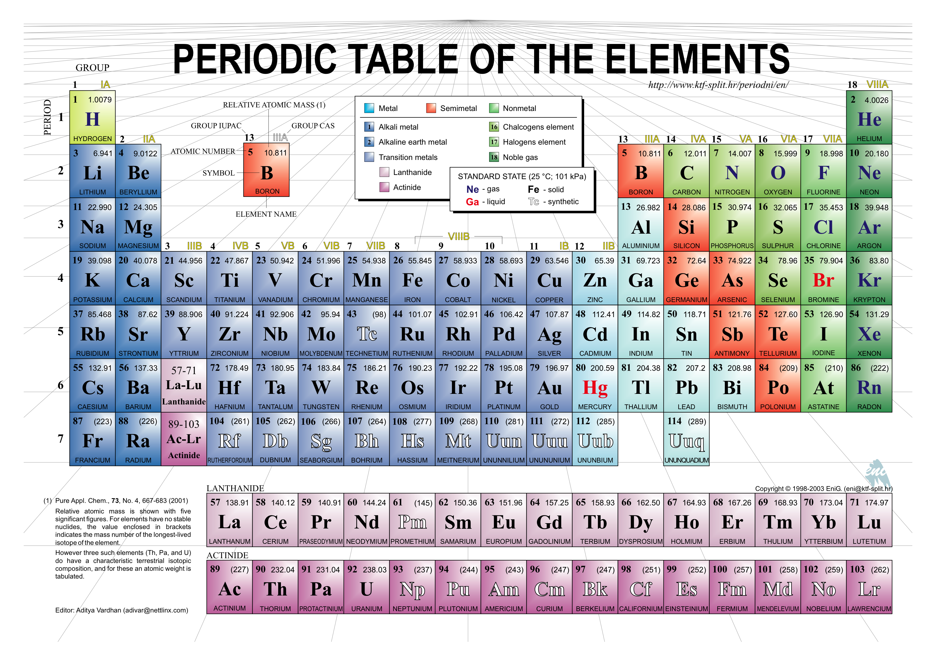
If you look at the Periodic Table of Elements below, you can see that you recognize the names of many of these elements. Elements include the oxygen (O) that you breathe and helium (He) for in balloons. They also include metals like silver (Ag), gold (Au), iron (Fe), and aluminum (Al).

Slide 13
The second type of molecule is something called a compound.
A compound is a substance that consists of two or more DIFFERENT types of atoms bonded together.
Let’s look at that water molecule mentioned earlier. Why do they call water H₂O?
That’s right! It’s because it has two hydrogen atoms and one oxygen atom bonded together. That makes H₂O a molecule and also a compound. You can see that the atoms are two DIFFERENT types.
H
H
O

Slide 14
An amazing thing about compounds is that when you combine the different types of atoms/elements, you often get a compound with properties that are very different from the properties of the atoms that made it.
Let me introduce you to a fellow agent, and you’ll see what I mean.

Slide 15
This is agent Sodium Chloride (NaCl). He is a compound made up of two different types of atoms
Na
Cl
Sodium (Na) is a metal that is poisonous.
Chlorine (Cl) is the white chemical that many people use to clean their swimming pools. In larger doses, it is also poisonous.
When you bond together two atoms that are poisonous, what do you get?

Slide 16
You get great tasting french fries!
That’s because agent NaCl is better known as table salt. Can you imagine eating french fries without this beautiful bonding of two poisonous elements?
My very own chemical formula is another great example. As we have already stated, water/H₂O is a bonding of two hydrogen atoms and one oxygen atom. Both hydrogen and oxygen are gases that are explosively flammable. When you bond them together, you get water, a liquid that certainly isn’t flammable.

Slide 17
Not everything that is two or more things put together is a compound, many of these combined things are mixtures.
A mixture is a combination of different substances that remain the same substances and can be separated by physical means.
In other words, the substances are not bonded together. Nothing NEW is created. It is the just the same substances mixed together.
A good example of a mixture is a fruit salad.

Slide 18
Let’s say the fruit salad contains bananas, apples, oranges, and grapes mixed together.
Do the fruits combine/bond to make a totally NEW fruit? Of course not.
In addition the fruit salad can be separated by physical means. To show what I mean, let’s say that you get this fruit salad, but you hate apples. What would you do?
You would either pick out the pieces of apple or eat around them. You can do this in a mixture because the apples are still apples. You can see them and separate them from the mix.

Slide 19
You cannot do this with a compound such as water. There is no way to physically reach in a pick out the oxygen (O) from the water. Even if you could break the chemical bonds, what was left would no longer be water. All you would have is a collection of hydrogen atoms.
Another difference between mixtures and compounds is that mixtures can have varying proportions within the mixture. Once again, let’s go back to the example of the fruit salad mixture.

Slide 20
No two scoops from the fruit salad bowl will have exactly the same amount of each fruit in it. If you don’t like apples, you may be able to scoop from an area of the fruit salad that doesn’t contain many apples.
Of course, if you would have made the fruit salad yourself, you would have avoided this problem all together by not putting any apples in it. This is an option with a mixture because the substances that go in it can vary.

Slide 21
In a compound, the substance that bond together are always the same. In addition, they always bond in the same proportions.
There is no such thing as water with less hydrogen. Each molecule of water must have exactly 2 hydrogen atoms bonded with 1 oxygen atom. There is no way of varying this.

Slide 22
Here is a short multiple choice test to see how well you have absorbed this information. In order to work with this agency, you must be able to learn and use information quickly.
Question 1
What is it called when two or more DIFFERENT types of atoms bond together?
an element B. a compound
C. a mixture D. molecule

Slide 23
That is incorrect.
Try again.

Slide 24
That’s correct!
In a compound there are DIFFERENT types of atoms bonded together
If you were thinking molecule, remember that a molecule is two or more atoms bonded together. Those atoms could be the same (an element) or different (a compound).

Slide 25
Question 2
What do you call a combination of different substance that remain the same substances and can be separated by physical means?
an element B. a compound
C. a mixture D. molecule

Slide 26
That is incorrect.
Try again.

Slide 27
That’s correct!
In a mixture the substances are combined, but are NOT bonded together.

Slide 28
Question 3
What do you call it when two or more of the SAME TYPE of atom bond together?
an element B. a compound
C. a mixture D. molecule

Slide 29
That is incorrect.
Try again.

Slide 30
That’s correct!
There may be millions and millions of atoms bonded together, but each is the SAME TYPE of atom.

Slide 31
Question 4
Pure gold is an example of ….
an element B. a compound
C. a mixture D. molecule

Slide 32
That is incorrect.
Try again.

Slide 33
That’s correct!
Although there may be millions and millions of gold atoms bonded together in even a small piece of gold, if it is PURE gold, then every atom is the SAME TYPE of atom (gold atoms).

Slide 34
Question 5
When two or more atoms bond together they form a ……
an element B. a compound
C. a mixture D. molecule

Slide 35
That is incorrect.
Try again.

Slide 36
That is one possibility, but there is a better answer.
Try again.

Slide 37
That’s correct!
Molecule is the BEST answer to the question. It’s true that compounds and elements are both collections of molecules and are not exactly wrong answers. However, in a compound the atoms have to be different. In an element the atoms have to be the SAME type. The question didn’t say whether the atoms were the same type or not. Therefore, molecule is the BEST answer.

Slide 38
That concludes this briefing. Remember to speak of this to NO ONE! If you do, we WILL find out! You will leave us no choice but to send a team of trained ninjas after you. They will catch you in the halls
and ……
give you a swirly after school.
Good Day recruits. H₂O out.

Slide 39
To preview a question sheet and test (with answer keys) that accompanies this presentation click below.
Atoms, Molecules, Elements, Compounds, and Mixtures Question Sheet and Test (with keys)
Here are other PowerPoint lessons in science.
Matter, Weight, Mass, and Volume PowerPoint Lesson(s) part 1
Matter, Weight, Mass, and Volume PowerPoint Lesson(s) part 2
All About the Moon PowerPoint Lesson(s)
The Scientific Method- A Red-Nosed Reindeer Mystery- PowerPoint Lesson(s)
Other Products – Nicole Paul page

